Slide 1
Unit - I
Dr.C.Therasa

Slide 2
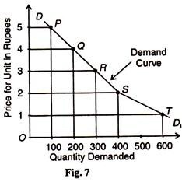
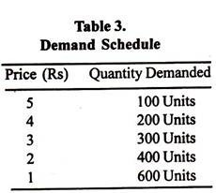
LAW OF DEMAND
Definition: The law of demand states that other factors being constant (cetris peribus), price and quantity demand of any good and service are inversely related to each other. When the price of a product increases, the demand for the same product will fall.

Slide 3
Exceptions to Law of Demand
War : If shortage is feared in anticipation of war, people may start buying for building stocks or for hoarding even when the price rises.
Depression: During a depression, the prices of commodities are very low and the demand for them is also less. This is because of the lack of purchasing power with consumers.
Giffen Paradox: If a commodity happens to be a necessity of life like wheat and its price goes up, consumers are forced to curtail the consumption of more expensive foods like meat and fish, and wheat being still the cheapest food they will consume more of it.

Slide 4
Exceptions to Law of Demand
Demonstration effect (Veblen’s effect): If consumers are affected by the principle of conspicuous consump­tion or demonstration effect, they will like to buy more of those commodities which confer distinction on the possessor, when their prices rise. On the other hand, with the fall in the prices of such articles, their demand falls, as is the case with diamonds
Ignorance effect: Consumers usually judges the quality of a commodity from its price. A low priced commodity is considered as inferior and less quantity is purchased. A high priced commodity is treated as superior and more quantity is purchased. Thus low-quality product may be purchased at a higher price, and it is just due to ignorance.

Slide 5
Speculation effect: A rise in the price of a commodity creates the impression among the buyers that its price will rise further. So people start buying more of the commodity when its price rises.
Necessities of life: These are the items purchased by consumers whatever may be the price. A consumer buys these commodities (staples, food material, clothing) irrespective of their higher price.

Slide 6
Law of Supply
The law of supply is an economic principle that helps explain how to appropriately price products based on how much supply is available of a product. The law of supply explains that if people are willing to pay more money for a product, a company will produce or manufacture more of that product to capitalize on the increased revenue.
When the iPhone 5 was released, there was not enough supply to meet the demand. Consumers were waiting outside Apple stores for days just in hopes they could be one of the lucky customers who left with a new phone on the release day. Because the demand was so high and the supply was restricted, Apple was able to charge a premium price, and consumers gladly paid the full amount.

Slide 7
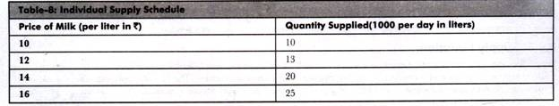
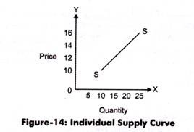
Law of Supply
The supply function can be expressed as:
Sx = f (Px)

Slide 8
Assumptions – Law of supply
Where:
Sx = Quantity supplied for product X
Px = Price of product X
f = Constant representing change produced in Sx with one unit change in Px
Assumptions:
Assumes that the price of a product changes, but the change in the cost of production is constant.
Assumes that the price of a product changes, but the change in the cost of production is constant.
Assumes that there is no change in the scale of production.
Assumes that the policies of the government remain constant.
Assumes that the transportation cost remain the same.
Assumes that there is no speculation about prices in future

Slide 9
Exceptions – Law of Supply
Exceptions:
Speculation: Refers to the fact that the supply of a product decreases instead of increasing in present when there is an expected increase in the price of the product.
Agricultural Products:
Imply that law of supply is not valid in case of agricultural products as the supply of these products depends on particular seasons or climatic conditions.
Changes in Other Situations:
Refers to the fact that law of supply ignores other factors (except price) that can influence the supply of a product. These factors can be natural factors, transportation conditions, and government policies.

Slide 10
Elasticity of demand
It is a measure of responsiveness or sensitiveness of one variable to change in some other variable. It is expressed in terms of a percentage and is deviod of any unit of measurement.
Ed = percentage change in demand / percentage change in price
e_{p} = ∆Q/∆P * P/Q 1855-1550 = 305 305/1550 = 20%
300 – 295 = 5 = 2% 2/20 = 0.1

Slide 11
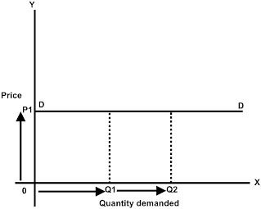
Price elasticity of demand
When the percentage change in quantity demanded is infinite even if the percentage change in price is zero, the demand is said to be perfectly elastic. Endless demand at given price.
Eg:- we can take example as bikes market. In today’s Indian bike market
The demand for bikes is increasing day by day without any effect of price change.

Slide 12
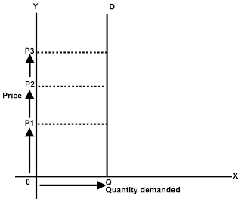
Perfectly inelastic
When the percentage change in quantity demanded is zero no matter how price is changed, the demand is said to be perfectly inelastic
Observe the graph, price of the goods changing or raises from P1 to P2 and P3 but there is no change in demand at Q.
Examples: Emergency services, drugs and essential food item
have perfectly inelastic demand. The price of food item may increase or decrease;
there will be no change in the demand for goods.
Example : 2 If the demand for natural gas is perfectly inelastic, the demand curve is vertical. Consumers will demand the same quantity regardless of price.
In this case, price controls will have no effect on the quantity demanded,
but they will still cause a shortage if the supply curve is upward sloping
and the regulated price is set below the market-clearing price,
because suppliers will produce less natural gas than consumers wish to purchase.

Slide 13
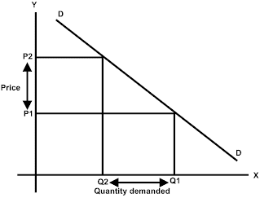
Unitary elastic
The proportion of change in demand is equal to proportion of change in price
Observe the graph, price of the goods increased from P1 to P2 and eventually the demand for the goods decreases from Q1 to Q2. The proportionate change in price is equal the proportionate change in demand
Example: The price of digital cameras increases by 10%,
the quantity of digital cameras demanded decreases by 10%.
The price elasticity of demand is (unitary elastic demand).

Slide 14
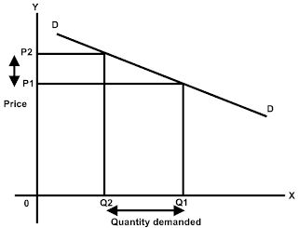
Relatively elastic
When the percentage change in quantity demanded is greater than the percentage change in price, the demand is said to be elastic.
Observe the graph, price of the goods increased from P1 to P2 and eventually the demand for the goods decreases from Q1 to Q2. But the proportionate change in price is less than the proportionate change in demand
Example: - there are commodities for which a small change in price will drastically reduce the amount of the commodity demanded. For example, air-travel for vacationers is very sensitive to price. An increase in the air fare will lead the vacationer to choose another mode of transportation like car or lead him to postpone the vacation plan for the time being. Thus for a rise in air fare for the vacationers we will see a relatively more drastic reduction in quantity demanded
and hence high price elasticity of demand.

Slide 15
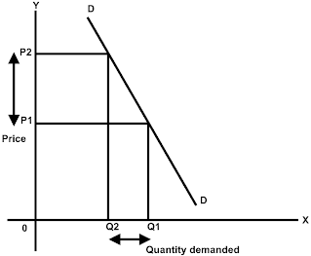
Relatively inelastic
More change in the price of the goods but less change in demand for the goods.
Observe the graph, price of the goods increased from P1 to P2 and eventually the demand for the goods decreases from Q1 to Q2. The proportionate change in price is more than the proportionate change in demand.
Example: if we observe the prices of petrol and comparing its demand change with the change in price levels of petrol (even though the price changes to great extent, there will not be much change in demand)

Slide 16
Price effect on demand – in case of substitutes and complements, unrelated goods
If the price of a commodity increases, the consumer will demand fewer of that commodity. If noodles and ketchup are complements, the demand for ketchup will drop (the demand curve will shift to the left), and the consumer will demand less ketchup
If the price of noodles increases, the consumer will demand fewer noodles. Since noodles and pasta are substitutes, the demand for pasta will increase (the demand curve will shift to the right), and the consumer will demand more pasta.

Slide 17
Price effect on demand – in case of substitutes and complements, unrelated goods
If the goods are unrelated. For eg, Food and clothing. You might think the demands for food and clothing would be independent of each other. However, because the consumer spends a fixed amount on the two, the demand for clothing will depend on whether the consumer spends more or less of her fixed budget on food after the price increase.
If the consumer’s demand elasticity for food is elastic, she will spend less on food, and therefore more of her fixed income will be available to spend on clothing. In this case, her demand for clothing increases, and she buys more clothing. The goods are substitutes in this situation.
If her demand for food is inelastic, however, she will spend more on food after the price increase, and therefore less on clothing. In this case, she will buy less of both goods in response to the price increase for food, so the goods are complements.
Finally, if her demand for food is unit elastic, she will spend the same amount on food and therefore will not change her spending on clothing. In this case, the goods are unrelated, and the demand curve for clothing is unchanged.
Important note: If two goods are substitutes the demand for one will increase and demand for other product will decrease and hence demand curve will shift towards right for the product whose demand is increased.

Slide 18
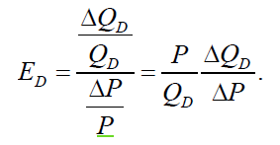

Problems
Price | Qty Supplied (Million) | Qty Demanded (Million)
3 | 2 | 34
6 | 4 | 28
9 | 6 | 22
12 | 8 | 16
15 | 10 | 10
18 | 12 | 4
A Vegetable fiber is traded in the local market.
Calculate the price elasticity of
demand when the price is 9.
With each price increase of Rs.3, the quantity demanded
Decreases by 6 million. Therefore
= -6/3 = -2

Slide 19

At P = 9, quantity demanded is 22 million and thus
9 / 22 (-2) = -0.82
Similarly, at P = 12, quantity demanded equals 16 million and
12 / 16 (-2) = -1.5

Slide 20
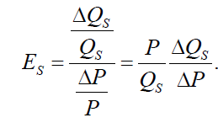


Elasticity of supply
With each price increase of $3, quantity supplied increases by 2 million.
Therefore
2/3 = 0.67
At P = 9, quantity supplied is 6 million and
9 / 6 (0.67) =1.005
Similarly, at P = 12, quantity supplied is 8 million and
12 / 8 (0.67) =1.005

Slide 21
Some questions related to price elasticity:
What are the equilibrium price and quantity?
The equilibrium price is the price at which the quantity supplied equals the quantity demanded.
Using the table, the equilibrium price is P* = 15and the equilibrium quantity is Q* = 10 million.
Suppose the government sets a price ceiling of Rs.12. Will there be a shortage, and if so, how large will it be?
With a price ceiling of Rs.12, price cannot be above Rs.12, so the market cannot reach its equilibrium price of Rs.15. At Rs.12, consumers would like to buy 16 million, but producers will supply only 8 million. This will result in a shortage of 8 million units.

Slide 22

Elasticity of demand
If a 6% increase in the price of Complan causes a 12% decline in the quantity demanded, what is the elasticity of demand?
Ans: The elasticity of demand is the percentage change in the quantity demanded divided by the percentage change in the price. The elasticity of demand for Complan is therefore
-12/ +6 = - 2

Slide 23
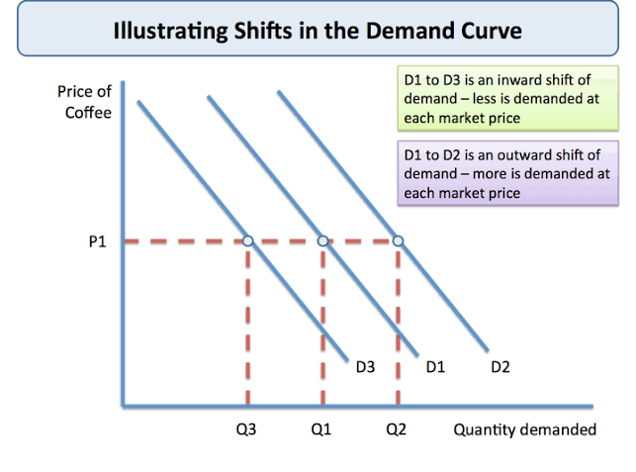
Shift in demand curve
Factors That Cause a Demand Curve to Shift:
Income of the buyers
Consumer trends
Expectations of future price
The price of related goods
The number of potential buyers

Slide 24
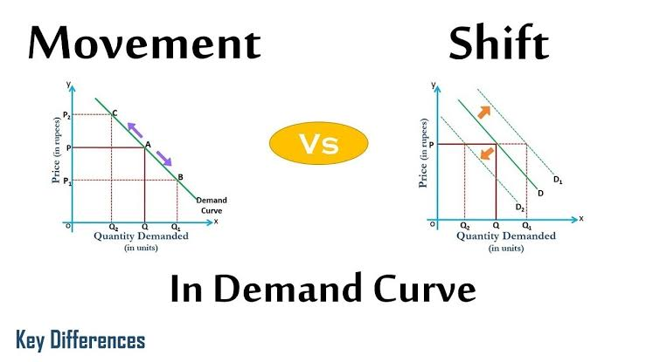

Slide 25
Demand is the quantity of a commodity, which a person is ready to buy at different prices over a period.
Movement in demand curve: When the quantity demanded of a commodity changes, due to the rise or fall in the prices of that commodity.
For example, if there is an increase in the price of petrol, there would be a movement along the demand curve, and a smaller quantity would be bought. However, there is likely to be only a small fall in demand because the demand for petrol tends to be quite price inelastic.
Shift in demand curve: change in the demand curve, due to non-price determinants i.e price of related goods, income of the consumer, changes in taste and preferences of the consumer etc. e.g. fashion changes or successful advertising campaign)

Slide 26
When there is movement only along the demand curve, this means price is the only factor that is changing.
When the entire demand curve shifts, it signals that other determinants of demand, excluding price, have changed.
Aside from price, other determinants of demand that affect the demand schedule or chart are: income, consumer tastes, expectations, price of related goods, and number of buyers.
Shift of the demand curve to the right indicates an increase in demand at whatever price because a factor, such as consumer trend or taste, has risen for it. Conversely, a shift to the left displays a decrease in demand at whatever price because another factor, such as number of buyers, has slumped

Slide 27
Shift and movement of demand – Consumer and seller reaction and its impact on price
Due to shift in demand from D1 to D2, a short-run excess demand will be created at the current price. Consumers will bid against each other putting some upward pressure on the price, and hence sellers will react by raising price. Then price of the commodity will rise until the quantity demanded and the quantity supplied are equal.

Slide 28
Welfare analysis
To determine the impact on trade policies, we must determine how the participants in the economy are affected.
Participants include
Consumer (Households)
Producers (Firm)
Government

Slide 29
Consumer surplus
Consumer Surplus (CS) is a method to determine the net benefit of consumption.
Definition: “ extra amount consumers are willing to pay for an item compared to what they have to pay”. Difference between the price consumers are willing to pay and what they actually pay
Graphically this is an area under the demand curve
Eg. If a consumer is willing to pay is Rs. 50 for a pen, but if the pen costs, only Rs. 30 the net gain is Rs. 20 which is called as consumer surplus.

Slide 30
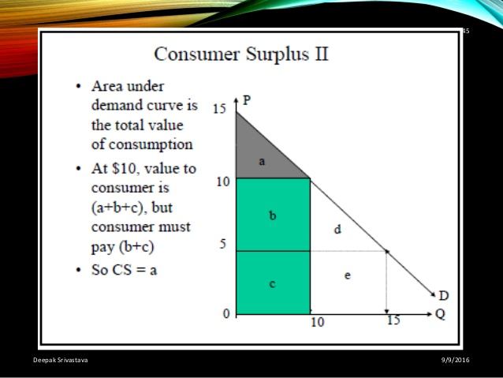

Slide 31
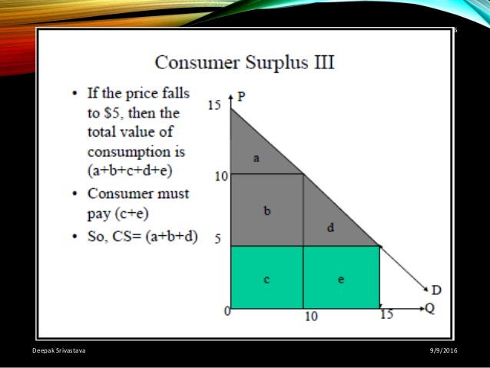

Slide 32
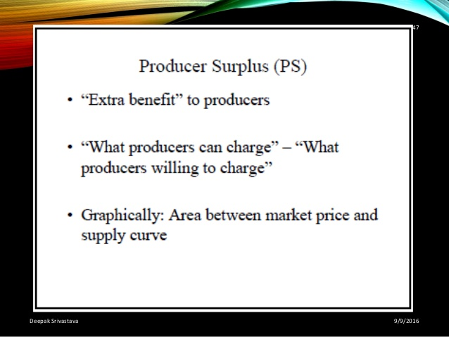

Slide 33
Price floor
A price floor or a minimum price is a regulatory tool used by the government. More specifically, it is defined as an intervention to raise market prices if the government feels the price is too low. In this case, since the new price is higher, the producers benefit. For a price floor to be effective, the minimum price has to be higher than the equilibrium price.
For example, many governments intervene by establishing price floors to ensure that farmers make enough money by guaranteeing a minimum price that their goods can be sold for. The most common example of a price floor is the minimum wage. This is the minimum price that employers can pay workers for their labor.

Slide 34
Theory of Consumer Behaviour
The principle assumption upon which the theory of consumer behavior and demand is built is: a consumer attempts to allocate his/her limited money income among available goods and services so as to maximize his/her utility ( satisfaction).

Slide 35
Individual choice
What guides these individual consumer decisions?
Why do consumers purchase some commodities and not others?
How do they decide how much to purchase of each commodity?
What is the aim of a rational consumer in spending income?
The theory of consumer behavior and choice is the first step in the derivation of the market demand curve
We begin the study of the economic behavior of the consumer by examining tastes.

Slide 36
Utility analysis
The analysis of consumer tastes is a crucial step in determining how a consumer maximizes satisfaction in spending income.
Utility- The ability of a good to satisfy a want
Total utility (TU) - The total satisfaction received from consuming a good or service.
Marginal utility (MU) - The extra utility received from consuming one additional unit of a good.
Util - The arbitrary unit of measure of utility

Slide 37
Cardinal and Ordinal Utility
Cardinal utility is the utility wherein the satisfaction derived by the consumers from the consumption of good or service can be measured numerically.
If we are willing to pay £5,000 for a second-hand Nissan Car, we can infer we must get 5,000 utils. In other words, the value of cardinal utility is related to the price we are willing to pay.
For example, if a Nissan car gives 5,000 units of utility, a BMW car would give 8,000 units. This is important for welfare economics which tries to put values on consumption.
The idea of cardinal utility is important to rational choice theory. The idea consumers make optimal choices to maximise their utility.

Slide 38
Ordinal utility states that the satisfaction which a consumer derives from the consumption of product or service cannot be measured numerically.
For example, we prefer a BMW car to a Nissan car, but we don’t say by how much.
When deciding where to go for lunch, we may just decide I prefer an Italian restaurant to Chinese. We don’t calculate the exact levels of utility.
Also, the idea of heuristics is that consumers don’t have the ability to make perfectly rational choices but make rough rules of thumbs and quick judgements.

Slide 39
Axioms of consumer preference
Preferences are complete - there always will be a choice but consumers establish a preference
Preferences are Reflective – Doesn’t matter the order
Preferences are Transitive - Apple > Orange, Orange>Banana, Apple > Banana
Preferences are continuous – No gaps in quantities and preference. We need continuity in demand curves
Non-satiation – never get enough
Diminishing Marginal Rate of Substitution – willingess to trade out for another

Slide 40
Indifference curves
Meaning of Indifference Curve:
The indifference curve analysis measures utility ordinally. It explains consumer behaviour in terms of his preferences or rankings for different combinations of two goods, say X and Y.

Slide 41
Theory of Consumer Behaviour
Wants may arise due to elementary and psychological causes (wants for food, clothing and housing)
Wants may arise due to social causes
Due to customs and habits like drinking tea and chewing
May arise due to advertisements
Consumption means using up of goods and services in the satisfaction of human wants.
The economics of consumption is related to the nature of wants and behaviour of demand

Slide 42
Characteristics of wants
Wants are unlimited.- bundle of desires.
Every want is satiable – single or particular want is satiable- completely a want is satisfied.
Wants are competitive – If a person has Rs.20 choosing to go movie, buying a book, fruits of course most urgent wants first
Wants are complementary – It has to be satisfied together. Want for writing includes paper, pen and ink. Some cases wants are both competitive and complementary (eg. Labor and machinery)

Slide 43
Wants are alternative: a want can be satisfied by two or more goods or by two or more methods. Want for hot drink – coffee or tea (substitutes)
Wants vary with time, place and person: require hot drinks in winter and cool drinks in summer. People of England requires warm woollen suits. Wants vary with generation, culture, society, geographic location
Some wants recur again: wants for food
Wants are influenced by advertisements: new wants are created
Wants become habits and customs: if want is satisfied repeatedly by a commodity eg. Drinking coffee and tea

Slide 44
Classification of wants
Necessaries: essential for living. Food clothing shelter
Comforts: goods which are not essential for living but which are required for a happy living. TV, SOFA, Cushioned revolving chair, eating fruits, etc.
Luxuries: goods that show-off one’s higher status in life (eg. Diamond-jewels)
These are only relative but not absolute concepts.
These classification depends on the income of the person, his social status and his taste and preferences

Slide 45
Concept of utility: Marshallian Approach
Two basic approaches to the study of consumer demand theory
Utility approach : cardinal utility analysis or marginal utility analysis or Marshallian utility analysis
Indifference curve approach : Ordinal utility (J.R.Hicks & R.G.D.Allen)
Utility: subjective or psychological concept – depends on the consumer and his need for the commodity
Total utility: sum of utilities of all units of a commodity
Eg : if a consumer consumes 10 biscuits, then TU is all 10 biscuits
Marginal utility: addition made to the TU by consuming one more unit of a commodity.if a consumer consumes 10 biscuits, the MU is the utility derived from the 10th unit.
MU(n) = TU(n) – TU(n-1)
MU(n) = Marginal utility of ‘nth’ commodity
TU(n) = Total utility of n units
TU(n-1) = Total utility of n-1 units

Slide 46
MU – Decline, Reaches zero, becomes negative
TU – Increases, Reaches maximum, Declines
Law of DMU – If a consumer takes more and more units of a commodity, the additional utility he derives from an extra unit of the commodity goes on falling. MU decreases with the increase in the consumption of a commodity
When MU decreases, TU increases at a diminishing rate.

Slide 47
DMU
Units of consumption must be in standard units. Cup of coffee, bottle of cool drink etc.
All the units of the commodity must be identical – taste, quality, color and size
Process of consumption continues without any time gap.
Consumer’s taste, habit or preference must remain same during process of consumption
Income of the consumer remains constant
Prices of the commodity consumed and its substitutes are constant
Rational economic man as he wants to maximise the total utility
Utility is measurable.

Slide 48
Price effect, Income effect and substitution effect
Price effect =
Change in demand for x commodity
Change in price of x commodity
Change in demand for x commodity
Substitution effect = change in price of y commodity (substitute goods)
Change in income of the consumer
Income effect = Change in demand for x commodity

Slide 49
Examples for income and substitution effect
Small income effect, small substitution effect: The amount of income that is spent on salt is very small, so the income effect is small. Because there are few substitutes for salt, consumers will not readily substitute away from it, and the substitution effect is therefore small.
Large income effect, small substitution effect: The amount of income spent on housing is relatively large for most consumers. If the price of housing rises, real income is reduced substantially, leading to a large income effect. However, there are no really close substitutes for housing, so the substitution effect is small.
Small income effect, large substitution effect: The amount of income spent on theater tickets is usually relatively small, so the income effect is small. The substitution effect is large because there are many good substitutes such as movies, TV shows, bowling, dancing and other forms of entertainment.
Large income effect, virtually no substitution effect: As with housing, the amount of income spent on food is relatively large for most consumers, so the income effect is large. Although consumers can substitute out of particular foods, they cannot substitute out of food in general, so the substitution effect is essentially zero.

Slide 50
Substitution effect is one of the most important reasons for the demand curve to slope downwards. Hicks tries to establish this with the help of indifference curve analysis.

Slide 51
Substitution effect
The consumer is in equilibrium at point E1.
Where IC1 is tangent to the price line PL .
He consumes M1 units of good x and N2 units of good y.
The income of the consumer and price of the good y is constant
There is a fall in price of good x. the price line rotates in the anti-
Clockwise direction and becomes PL2. The new price line is relatively
Flat. It reflects the relative cheapness of good x. A change in price
Brings a change in slope of the price-line. After the fall of price of good x
The consumer will buy more of good x because of two reasons.
Good x becomes relatively cheap
Income of the consumer goes up.

Slide 52
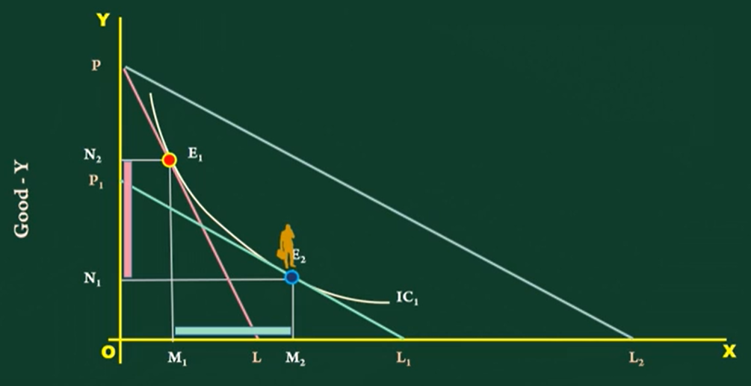
Substitution Effect

Slide 53
Indifference curve
Based on Ordinal approach, since it explains the behaviour of the consumer.
It is based on the ‘Scale of Preference’. Suppose a consumer has with him Rs.5 to spend on two commodities say a book and a pen. If he spends that amount in the purchase of a pen, it is evident that he ‘prefers’ the pen to a book as the utility derived by him in the pen is larger than in the book.
Another example, if a man who plans his consumption has Rs.10 which he can spend in units of two rupees each. In decising how to spend, the man will have to decide what he should do first and what he would do afterwards. Suppose he spends the first Rs.2 in seeing a movie, second Rs.2 in taking meal, third in buying a book, and fourth in pen and fifth in chocolate then that is called as the ‘ scale of preference’.

Slide 54
Indifference Curve
Scale of Preference:
1 | Movie | A
2 | Meal | B
3 | Book | C
4 | Pen | D
5 | Chocolate | E
It may be quite interesting to study the behavior of people if the products are
Substitutes and complements.
Complementary goods: Printer and inkjet. (because they are used together)
Substitute goods: Redmi vs Samsung mobile
(any goods used instead of other good)

Slide 55
Assumptions to indifference curves
1. consumer possess complete information about all aspects of economic environment
2. He behaves rationally, ie., with given income and prices of good, consumer will choose the combination of goods so as to get maximum satisfaction.
This analysis assumes ‘continuity’. ie., consumers are capable of ordering or ranking all combination of goods according to their satisfaction
Consumer is not interested in any one commodity, ratger in a combination of goods.
Consumer has an indifference map for a pair of commodities. And also his scale of preferences will remain constant.
Consumer had a fixed amount of money to spend on two goods and entire money should be spent on two goods and should not be saved.
Prices of these goods are given in the market and are assumed to be constant.

Slide 56
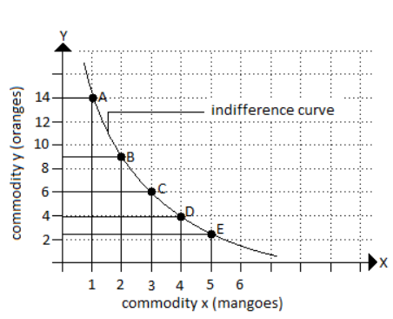
Illustration
combination | Mangoes | Oranges | Rate of substitution
A | 1 | 14
B | 2 | 9 | 1:5
C | 3 | 6 | 1:3
D | 4 | 4 | 1:2
E | 5 | 2.5 | 1:1.5
2-1 =1
14-9 = 5
Marginal Rate of substitution

Slide 57
Every indifference curve represents one satisfaction. All the points in the same indifference curve represent equal satisfaction. It is because that one commodity is substitutes for another commodity while the consumer moves down on an indifference curve.
Suppose the consumer moves down on an indifference curve, this means he gives up y-axis commodity so that loss in y-commodity is counter-balanced by the gain in x-commodity which results in equal satisfaction. This sort of substitution of y commodity with x commodity or vice-versa to make the level of satisfaction constant is called as ‘Marginal Rate of Substitution’.
It is the rate at which an individual exchange successive units of one commodity for another.
the concept of indifference curve is based on the properties of diminishing marginal rate of substitution.

Slide 58
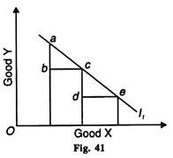
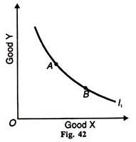
Indifference curves in case of substitutes and complements
If the two goods are close substitutes, such as coarse rice and wheat,
there is the high degree of substitutability of the two goods.
The MRS of one for the other is a constant number. In this case,
the slopes of the indifference curves are constant,
and the indifference curves are therefore linear. If the consumer is always
willing to trade one for one, his MRS is equal to 1.
If the two goods are perfect complements
the indifference curve is right-angled or L shaped. In this case the consumer
wants to consume the two goods in a fixed proportion, say one unit of
good 1 for every one unit of good 2. If she has more of one good than the
other, she does not get any extra satisfaction from the additional
units of the first good.

Slide 59
Budget line or Price line
According to Prof. Salvatore, “The budget line shows all the different combinations of the two commodities that a consumer can purchase, give his or her income and the price of the two commodities.”
Suppose the consumer has income of Rs.6 and a unit of food costs Rs.1.50 and a unit of clothing Re.1.
He can spend all the mibey on food alone or clothing alone or between the two. Assuming he spends on food, he can get 4 units of food; similarly if he spends on clothing alone, he can buy 6 units of clothing. Thus two possibilities are open to the consumer. The line which is the consumption possibility line representing various possibilities of combinations open to the consumer with his income Rs.6. is called price line or Budget line.

Slide 60
Budget line – if good is inferior and normal good
For eg, Food and clothing. No, the goods cannot both be inferior; at least one must be a normal good. Here’s why. If an individual consumes only food and clothing, then any increase in income must be spent on either food or clothing or both.
If food is an inferior good, then as income increases, consumption of food falls. With constant prices, the extra income not spent on food must be spent on clothing. Therefore as income increases, more is spent on clothing, i.e., clothing is a normal good.

Slide 61
Shift in budget line
Ram buys five new HP laptops for his company on 2019 at a cost of $40 each. But the refurbished laptops cost only $30 each. When the HP company announces that there will be a 10% increase in the price of new HP Laptops and a 5% increase in the price of refurbished laptops , Ram’s friend is giving $20 as extra money to use in his business.
Ram’s budget line: $ 1200 (income / $ 40 (price) = 30 (Quantity),
$ 1200 / $ 30 = 40
Income = (Price x* Quantity x) + (Price y* Quantity y)
M= Px * Qx + Py * Qy
1200 = 40 New + 30 Refurbished
1220 = 44 New +31.5 Refurbished – New Budget line after price rise

